Slide 1
An Introduction to ECF
Chris Aniszczyk <zx@us.ibm.com>
Software Engineer
IBM Lotus

Slide 2
Agenda
Background
  ~15 minutes
Demos
  ~10 minutes
API Introduction
  ~5 minutes
Conclusion
  ~15 minutes
Q&A

Slide 3
Agenda
Background
Demos
API Introduction
Conclusion
Q&A

Slide 4
Background
Eclipse does many things well…
  World-class Java IDE (JDT)
  Fantastic Web Development tooling (WTP)
  Database tooling (DTP)
  and so on…
…but lacks support for true collaboration
  Messaging
  Shared Editing
  Shared Debugging
  etc…
Enhanced support for collaboration within the context of Eclipse can increase productivity

Slide 5
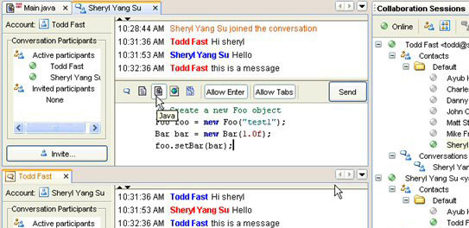
Background
Competition is good ☺
Netbeans
  http://collab.netbeans.org

Slide 6
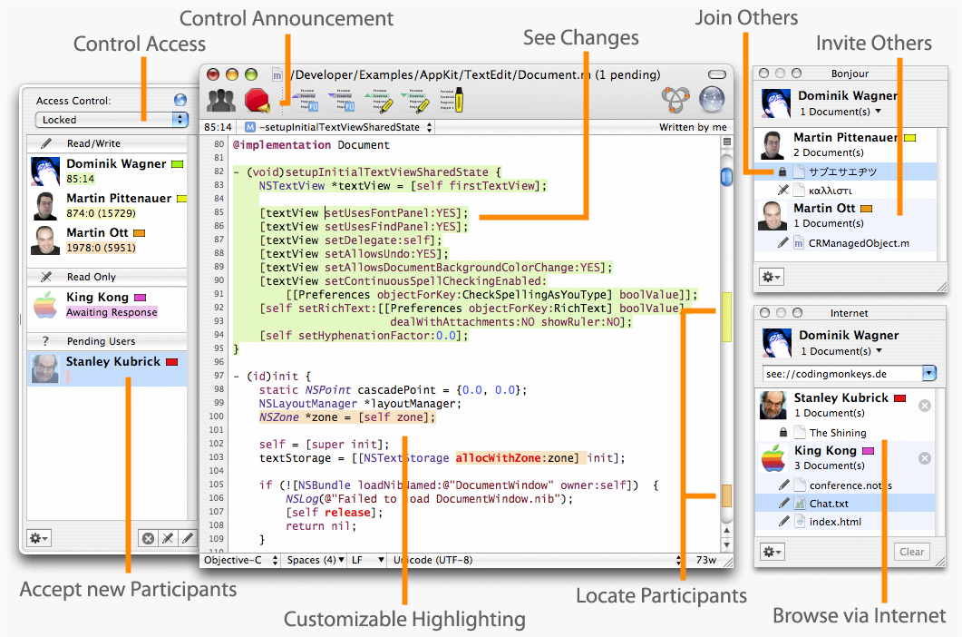
Background
Subthaedit
  http://www.codingmonkeys.de/subthaedit

Slide 7
Background
Solution?
The Eclipse Communications Framework (ECF) to the rescue!
  Yet Another #$!!@! Framework
    A cross-protocol communications framework for Eclipse/RCP
    ECF provides a set of high-level abstractions, rather than yet another messaging API to support various communications components.
    With ECF, development can be expedited over all the communication code for each of those components, allowing you to focus on business logic and UIs.
Notes:
This design choice empowers you to reuse high-level communications components (instant messaging, file sharing, video conferencing, etc.) in varying application contexts and UIs. Imagine developing an application that requires instant messaging, blogging, BitTorrent, file sharing, and voice conferencing.

Slide 8
Background
ECF creates value for 4 groups
  Communications providers (Yahoo, GoogleTalk/XMPP, etc…)
    Adoption & Interoperability
  Component developers (file-sharing, screen-sharing, etc…)
    Reusability
      Developers can reuse components
  Tool integrators
    Feature enrichment
      Developers can breathe new life into their existing applications
  UI developers
    Usability
      UIs can be improved/customized independent of underlying implementation

Slide 9
Demos

Slide 10
Demos
Eye candy is important ☺
  XMPP (GoogleTalk) IM, Yahoo IM
    Who wants to chat with me ;)?
  IRC
    irc://irc.freenode.net/#eclipse-dev
  Shared Workspaces
    URL Sharing
    Shared Editing

Slide 11
Agenda
Background
Demos
API Introduction
Conclusion
Q&A

Slide 12
API Introduction
Interoperability through protocol
  org.eclipse.ecf.core.IContainer
  Goal
    Simple API / Extensibility via OSGi model / getAdapter(…)
Clients use the IContainer API
  IContainer container = ContainerFactory.getDefault().createContainer(“ecf.xmpp.smack”);
  Container.connect(…)
Semantics
  Connection/Disconnection/LifeCycle
    c.connect(ID, IConnectContext)
    …
    c.disconnect()
  Protocol Adapters – getAdapter(…) abuse…
    container.getAdapter(<interface>);
    IFileshareContainer fsc = (IFileshareContainer) c.getAdapter(IFileshareContainer.class)

Slide 13
API Introduction
IAdaptable abuse (we love the adapter pattern)
  Presence/IM/Chat
  Dynamic Service Discovery (zeroconf, etc…)
  Datashare (channels)
  File sharing
  Call (SIP…)

Slide 14
API Introduction
Two Extension Points
  org.eclipse.ecf.containerFactory
    ECF providers can implement their own IContainer
      Current
        XMPP/Jabber, IRC, JMS, Yahoo
      Future
        SIP, JXTA, Jingle, Sametime, AIM, etc…
  org.eclipse.ecf.namespace
    ECF providers can implement their own addressing
      e.g., xmpp://zx@ecf.eclipse.org

Slide 15
Agenda
Background
Demos
API Introduction
Conclusion
Q&A

Slide 16
Conclusion
Future Direction
  Corona Integration (http://www.eclipse.org/corona/)
    OSGi-based SOA component framework for server-side Eclipse plug-in deployment
      ECF usage for event reporting / resource sharing
  New “sub-projects”
      Shared Editing
      Call API/VOIP/Asterisk/GoogleTalk
        RCP Soft-phone
      Application Sharing/VNC
      ECF+OSGI for Servers
        RSP (Rich Server Platform) / Equinox Servlet Incubator…

Slide 17
Conclusion
Google’s Summer of Code Projects (http://code.google.com/soc)
  ECF BitTorrent Provider
    Create an EPL’d BT implementation that will be used by the file-sharing API
    Investigate integration with Eclipse’s Update Manager
  Real-time Shared Editing Support
    Enable pair-programming sessions in Eclipse, really ;)
    Possibly use the SubEthaEdit protocol
  SharedCode Plugin (SCP)
    Provide an easy to use UI to search and share source code amongst developers

Slide 18
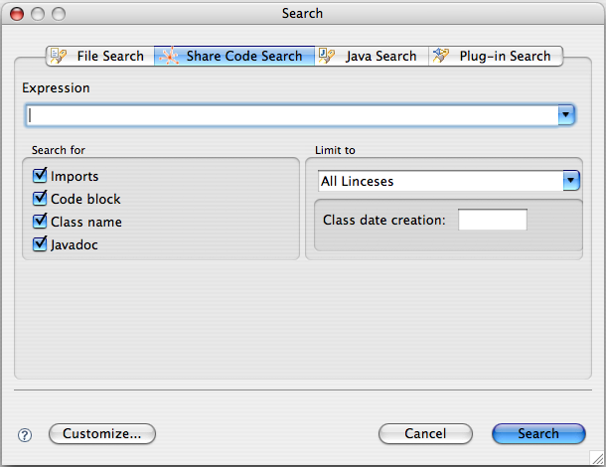
Conclusion

Slide 19
Conclusion
Support from the community welcomed and appreciated!
  Ways to help
    Improve / Extend existing applications
    Build provider implementations
    Contribute to API Design (we need feedback!)
    Join ECF Community! (commercial or not!)
Website
  http://www.eclipse.org/ecf
Mailing List
  http://dev.eclipse.org/mailman/listinfo/ecf-dev
Newsgroup
  news://news.eclipse.org/eclipse.technology.ecf

Slide 20
Agenda
Background
Demos
API Introduction
Conclusion
Q&A

Slide 21
Questions

Slide 22
Thank You
Chris Aniszczyk <zx@us.ibm.com>
http://mea-bloga.blogspot.com
http://www.eclipse.org/ecf

